Slide 1
The Role of Knowledge Management in Enhancing Service Quality and Sustainability in Nepal's Tourism Industry
Prabesh Adhikari
MBA IT 8th Batch
May, 2025

Slide 2
Research Overview
Focus Area: Knowledge Management in Nepal's tourism sector, particularly trekking and eco-tourism
Key Issue: Despite being knowledge-intensive, Nepal's tourism lacks systematic KM
Importance: Tourism contributes 7.9% of Nepal's GDP & 1.05 million jobs (pre-pandemic)
Approach: Mixed-methods case study research examining KM practices, barriers, and impacts

Slide 3
Research Matters?
Unique Context: Nepal's extraordinary biodiversity and cultural heritage
Critical Gap: "The importance of knowledge management is not well captured in the tourism sector of Nepal" (Kharel et al., 2022)
Government Recognition: Protected Areas Management Strategy (2022-2030) identifies "limited information and database" as major hindrance
Timeliness: Post-pandemic recovery phase when tourism stakeholders seek competitive advantages

Slide 4
KM in Tourism
Knowledge Types: Environmental, cultural, operational, and marketing information
KM Processes: Knowledge acquisition, storage, sharing, and application
Theoretical Framework: Nonaka's SECI model (Socialization, Externalization, Combination, Internalization)
Knowledge Forms: Tacit (trail expertise, cultural insights) & Explicit (manuals, databases)

Slide 5
Research Questions
What are current KM practices in Nepal's trekking and eco-tourism sector?
How do knowledge acquisition and sharing processes influence service quality?
To what extent do KM practices contribute to sustainability initiatives?
What organizational, technological, and cultural factors facilitate or hinder knowledge utilization?

Slide 6
Research Objectives
Identify and analyze current KM practices in selected tourism organizations
Evaluate how knowledge processes influence service quality outcomes
Assess the role of KM in supporting sustainable tourism practices
Identify barriers and enablers to effective knowledge utilization

Slide 7
Research Hypothesis
H1: Higher KM awareness correlates with greater adoption of KM practices
H2: Better IT infrastructure leads to more effective knowledge sharing
H3: Organizations with stronger KM enablers (learning culture, trust, leadership) demonstrate better sustainability performance
H4: Active KM implementation correlates with higher tourist satisfaction and conservation awareness

Slide 8
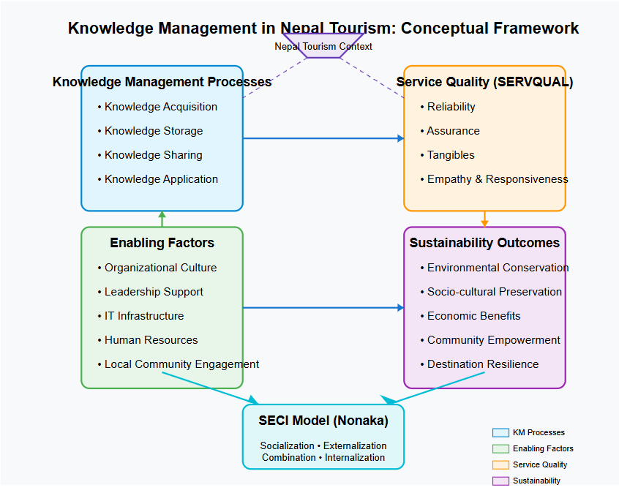
Conceptual Framework

Slide 9
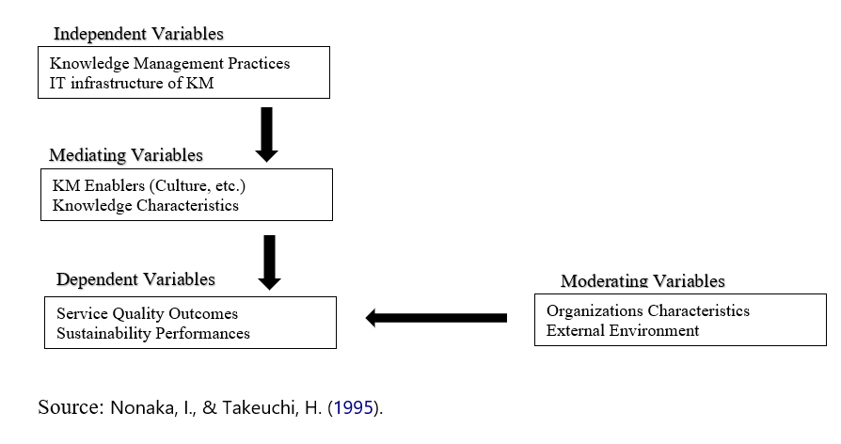

Slide 10
Research Methodology
Mixed-Methods Approach:
Phase 1: Quantitative survey of 50+ tourism organizations
Phase 2: Qualitative case studies (8-10 organizations)
Phase 3: Integration and synthesis of findings
Sampling: Stratified random sampling (quantitative) and maximum variation purposive sampling (qualitative)

Slide 11
Analytical Plan
Quantitative Analysis:
Descriptive statistics, correlation, regression
ANOVA, Structural Equation Modeling
Qualitative Analysis:
Thematic analysis, content analysis
Cross-case comparisons, process mapping
Integration: Joint display analysis, typology development

Slide 12
Research Timeline
Phase | Activities | Duration
Preparation | Literature review, instrument development | 15 Days
Quantitative Data Collection | Survey distribution and collection | 30 Days
Quantitative Data Analysis | Statistical analysis of survey data | 10 Days
Qualitative Data Collection | Case study interviews and observations | 30 Days
Qualitative Data Analysis | Thematic analysis of interview data | 10 Days
Integration | Synthesis of quantitative and qualitative findings | 25 Days
Report Writing | Preparation of thesis and recommendations | 25 Days

Slide 13
Expected Contributions
Academic Contributions:
Extend KM theory to nature-based tourism contexts
Bridge gap between KM research and practice
Context-specific KM practices for developing economies

Slide 14
Expected Contributions
Practical Contributions:
Actionable recommendations for tourism stakeholders
Evidence-based strategies for improving service quality
Knowledge sharing mechanisms to enhance sustainability

Slide 15
Conclusions
KM is critical yet underutilized in Nepal's tourism industry
This research will identify paths to improve knowledge flows
Findings will benefit multiple stakeholders:
Tourism enterprises seeking competitive advantage
Communities seeking sustainable tourism development
Conservation agencies managing protected areas
Policymakers designing tourism strategies

Slide 16
References
Cooper, CP (2018) Managing Tourism Knowledge: A Review Tourism Review. Tourism Review, 73 (4). pp. 507-520. ISSN 1660-5373 DOI: https://doi.org/10.1108/TR-06-2017-0104
Craik, J. (1995) Are There Cultural Limits to Tourism? Journal of Sustainable Tourism 3:87–98.
Deb, S. K., Kuri, B. C., & Nafi, S. M. (2024). Application of knowledge management in tourism and hospitality industry: A sustainable approach. In M. Valeriu (Ed.), Knowledge management and knowledge sharing: Business strategies and an emerging theoretical field (pp. 99–116). Contributions to Management Science.
G Shaw and A M Williams (2009), ‘Knowledge Transfer and Management in Tourism Organisations: an emerging research agenda’, Tourism Management 30 (3) 325–335
Inskeep, E. (1991) Tourism Planning: An Integrated and Sustainable Development Approach. New York: Van Nostrand Reinhold. Jones, S. 2005 Community-based Tourism: The Significance of Social Capital. Annals of Tourism Research 32:303–324
Jayasekera, K. G. T., Albattat, A., & Azam, S. M. F. (2022). Managing knowledge in tourism industry: A Nonaka’s SECI model. International Journal of Multidisciplinary Research and Publications, 5(7), 73–78.
Kharel, S., K. C. A., Devkota, N., & Paudel, U. R. (2022). Entrepreneurs’ level of awareness on knowledge management for promoting tourism in Nepal. International Journal of Innovation and Technology Management, 19(1), 1–19.

Slide 17
Maharjan, P. (2022). Influence of demographic characteristics of knowledge management enablers in Nepalese hospitality industry. Nepalese Journal of Hospitality and Tourism Management, 3(1), 1–13.
Nepal, Department of National Parks and Wildlife Conservation. (2022). Protected area management strategy 2022–2030. Government of Nepal.
Jayasekera, K. G. T., Albattat, A., & Azam, S. M. F. (2022). Managing knowledge in tourism industry: A Nonaka’s SECI model. International Journal of Multidisciplinary Research and Publications, 5(7), 73–78.
Kharel, S., K. C. A., Devkota, N., & Paudel, U. R. (2022). Entrepreneurs’ level of awareness on knowledge management for promoting tourism in Nepal. International Journal of Innovation and Technology Management, 19(1), 1–19.
Maharjan, P. (2022). Influence of demographic characteristics of knowledge management enablers in Nepalese hospitality industry. Nepalese Journal of Hospitality and Tourism Management, 3(1), 1–13.
Nepal, Department of National Parks and Wildlife Conservation. (2022). Protected area management strategy 2022–2030. Government of Nepal.

Slide 18
Nonaka, I., & Takeuchi, H. (1995). The knowledge-creating company: How Japanese companies create the dynamics of innovation. Oxford university press.
Otowicz, M. H., Lacerda, L. L., Emmendoerfer, L., & Biz, A. A. (2022). Tourism, knowledge management and its processes: An integrative literature review. Revista Brasileira de Pesquisa em Turismo, 16, Article e2368.
Rudie, Mary, J. and H. Brant Wansley (1985), “The Merrill Lynch Quality Program,” in Services Marketing in a Changing Environment, Thomas Bloch, Gregory Upah, and Valarie A. Zeithaml (eds.), Chicago, IL: American Marketing Association
Tzortzaki, A.M. and Mihiotis, A., (2014), “A review of knowledge management
theory and future directions”, Knowledge and Process Management, Vol. 21 No. 1, pp.29-41.

